Slide 1
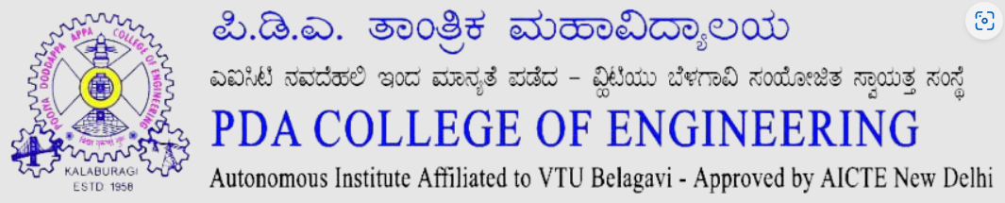
Department Of Computer Science And Engineering Computer Science And Design Program
Presented by
Madiha Azam: 3PD22CG048
Bhagyashree C :3PD22CG006
Guided by
Dr. Amareshwari Patil

Slide 2
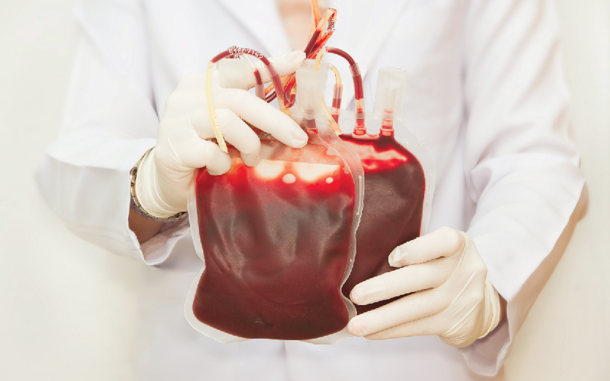
Blood Bank and Organ Donation Management System

Slide 3
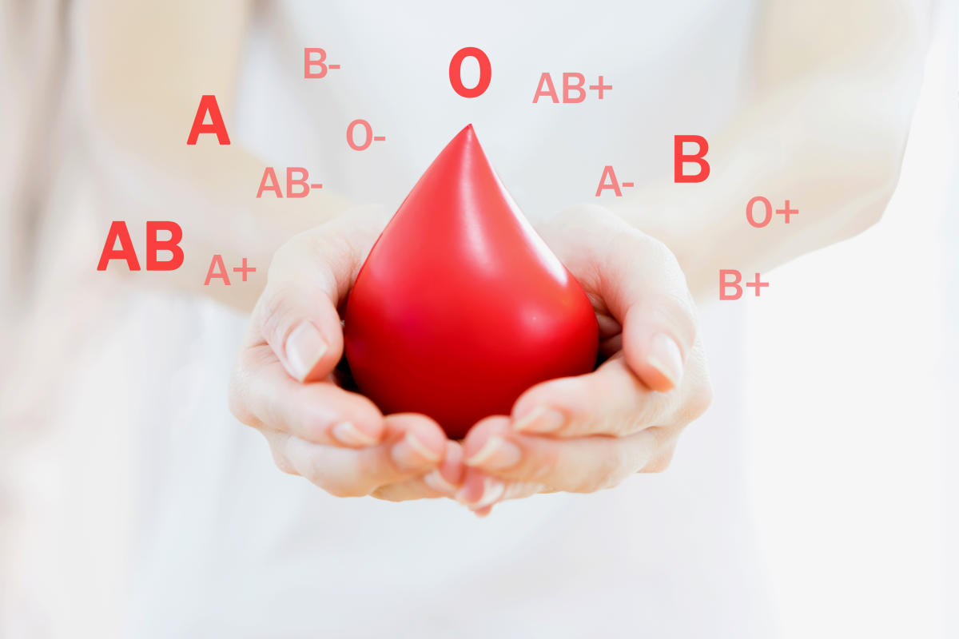
TABLE OF CONTENT:
Abstract
Introduction
Literature survey
Problem statement
Proposed work
Software requirements
Design and methodology
Conclusion
References

Slide 4
Abstract
The Blood Bank and Organ Donation Management System is an innovative solution designed to address the growing demand for organ donations and streamline the process of organ matching between donors and recipients. This web-based platform allows individuals to register as organ donors, request organs, and maintain real-time updates on organ availability across various hospitals. Using a secure database and cloud technologies, the system ensures that critical information is easily accessible to both recipients and healthcare professionals. The system utilizes HTML, CSS, and JavaScript for the front-end design, providing a user-friendly interface, while Python-Django serves as the backend framework for robust data processing and functionality. MySQL/Firebase is used for database management, ensuring secure and scalable storage of user and hospital data. The system also incorporates cloud technology for real-time updates on organ availability and matching

Slide 5

Introduction
Blood Bank and Organ Donation Management System is a life-saving practice that involves the donation of organs or tissues from one individual to another in need. The Organ Donation Management System aims to streamline the process of organ donation by creating a structured platform for donors, recipients, and healthcare organizations. It provides functionalities for donor registration, maintaining a real-time database of available organs, and ensuring ethical and legal compliance.

Slide 6
Problem statement
There are less websites in the market related to these . So many people are dying due to Blood Bank & Donor Management
organ insufficiency, and they can’t run to hospitals in a critical time. There is no guarantee that a specific organ is present at that time at a region/state. By overcoming all those things, we created this website, , where users can easily register themselves for donation, and they can easily request an organ. we will collect data from various hospitals and various states and update data using Python APIs.

Slide 7
Proposed solution
The proposed work for the Blood Bank and Organ Donation Management System involves creating a comprehensive platform to connect organ donors and recipients efficiently. User data, organ availability, and hospital information will be securely stored and managed in Google Cloud, enabling real-time updates and seamless coordination. The system utilizes HTML, CSS, and JavaScript for the front-end design, providing a user-friendly interface, while Python-Django serves as the backend framework for robust data processing and functionality. MySQL/Firebase is used for database management, ensuring secure and scalable storage of user and hospital data. The system also incorporates cloud technology for real-time updates on organ availability and matching

Slide 8
Literature survey
Author | Description and techniques used | Result and analysis
Abhay Yadav et al. (2023) | Developed a mobile and web-based platform to streamline the organ donation process by simplifying donor-recipient registration and matching. encryption, and a user-friendly interface were key design elements. | His platform successfully improved donor-recipient matching, reducing waiting times and increasing donor registration. Awareness campaigns integrated within the platform dispelled myths and encouraged more people to become donors.
Chester County Hospital (2021) | Introduced digital registries for organ donation, allowing individuals to sign up as donors through mobile apps and websites. The initiative aimed to simplify the registration process and increase accessibility for potential donor | The digital registry successfully reduced administrative barriers, leading to an increase in donor registrations. The convenience of online registration encouraged more people to register as donors, significantly improving participation rates.
V. B. Kute (2022) | Analyzed renal transplant outcomes and proposed strategies to improve success rates. The study focused on the use of digital platforms to track organ availability and improve logistical processes for organ transplants | The implementation of digital tracking systems was shown to improve the efficiency of organ allocation and reduce waiting times for transplant recipients. The study highlighted that real-time monitoring enhanced organ preservation and transplant success rates.

Slide 9
Author | Description and Techniques Used: | Results and Analysis:
Transplant Quebec (2019) | Emphasized the adoption of online platforms and public education campaigns to improve organ donation processes. Techniques included leveraging digital systems for donor-recipient matching and implementing targeted awareness programs to engage communities. | The initiative improved donor-recipient matching accuracy, significantly reducing organ wastage and increasing successful transplants. Public education campaigns boosted awareness, leading to higher donor registration rates and better community understanding of organ donation
Tepper, A., & Bhattacharya, S. (2020) | Tepper, A., & Bhattacharya, S. (2020) explored the use of artificial intelligence (AI) in organ transplantation to enhance donor-recipient matching and predict transplant outcomes. Techniques involved machine learning algorithms to analyze compatibility factors and predict long-term success rates of transplants. | The application of AI significantly improved the accuracy and speed of donor-recipient matching, reducing waiting times and organ wastage. Predictive models provided valuable insights into transplant success, helping healthcare providers make informed decisions.
Reddy, M., & Kumar, V. (2019) | Reddy, M., & Kumar, V. (2019) focused on incorporating data analytics into organ donation systems to enable real-time allocation and matching. Techniques involved analyzing large datasets of donor and recipient information, including compatibility factors, medical history, and geographic proximity. | The integration of data analytics enhanced the efficiency of donor-recipient matching, reducing organ wastage and waiting times. Predictive models improved the accuracy of organ allocation decisions, leading to better transplant outcomes.

Slide 10
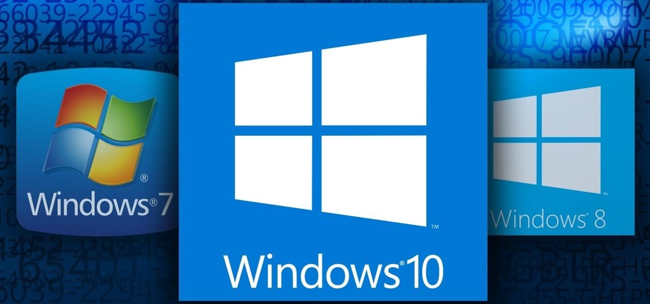
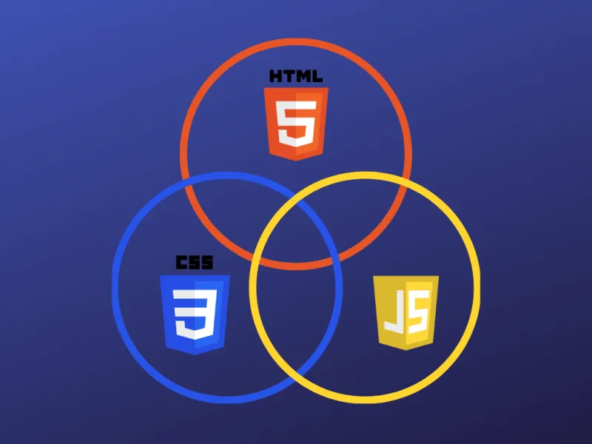
Software requirements
Operating System : Windows 8 or 10
Database Server : MySQL Cloud (Firebase)
Clients
Google Chrome
Internet Explorer
4. User Interface (UI) : HTML
CSS
XML
JAVA 7 (5.3.2)
Hardware requirements
PC with 128GB hard disk and 256MB RAM
Mobile having SDK version above 25.5.3.3

Slide 11
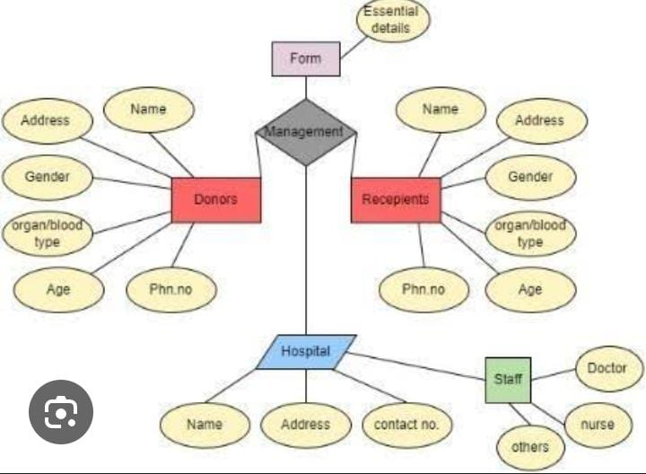
Design and methodology

Slide 12
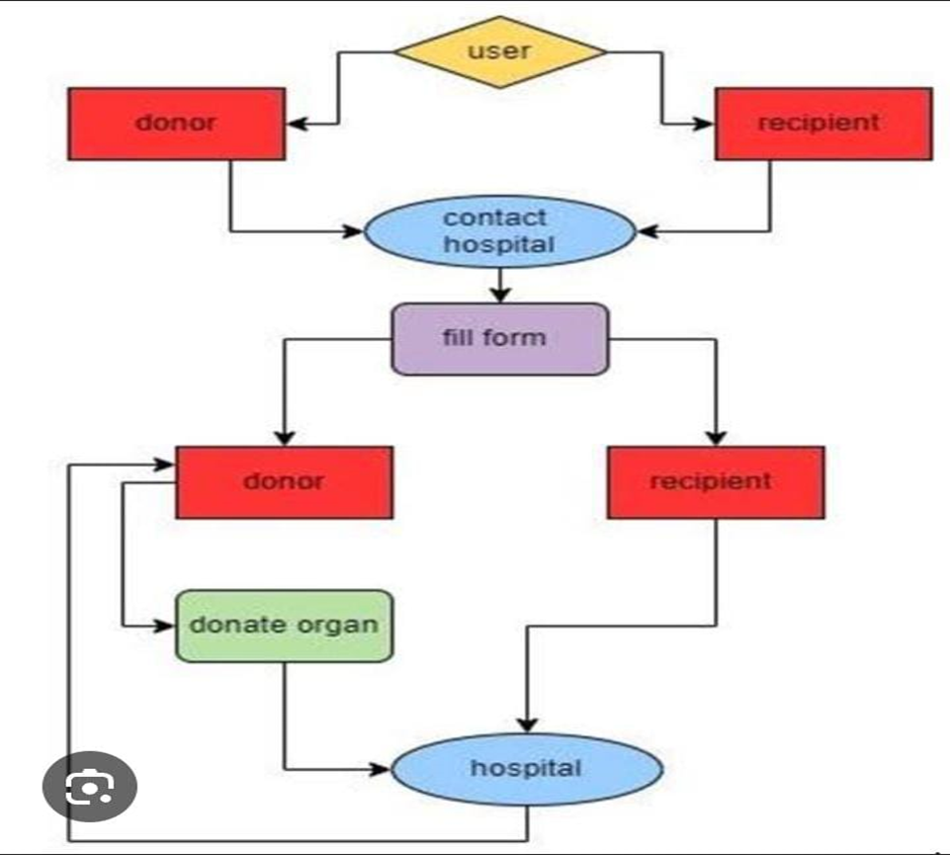
Blood Bank and Organ Donation Management System

Slide 13
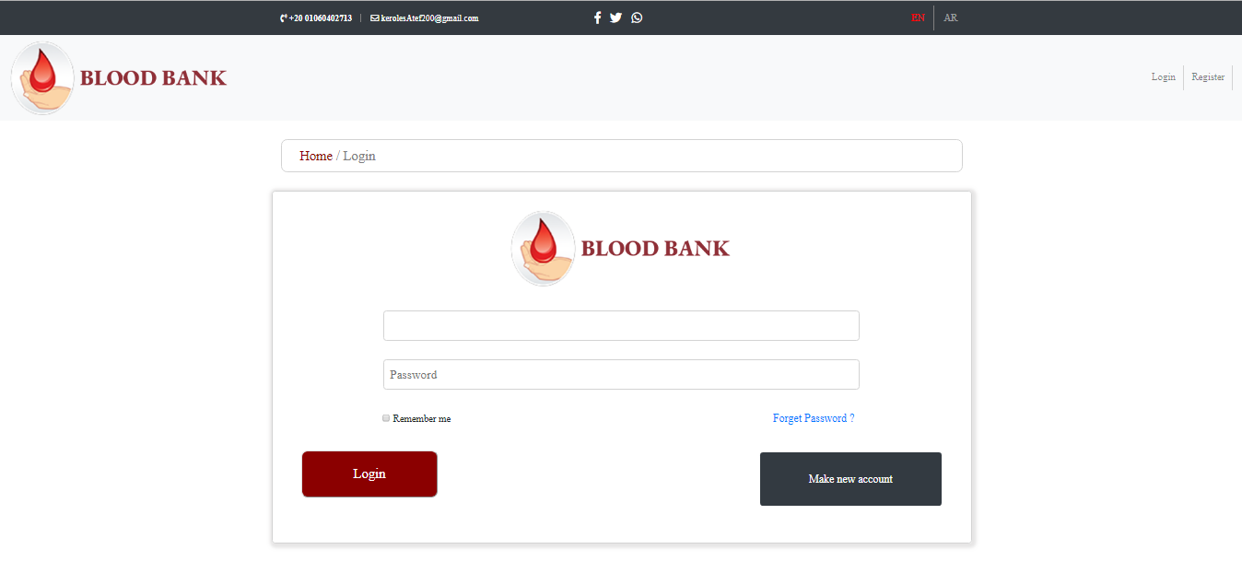

Slide 14
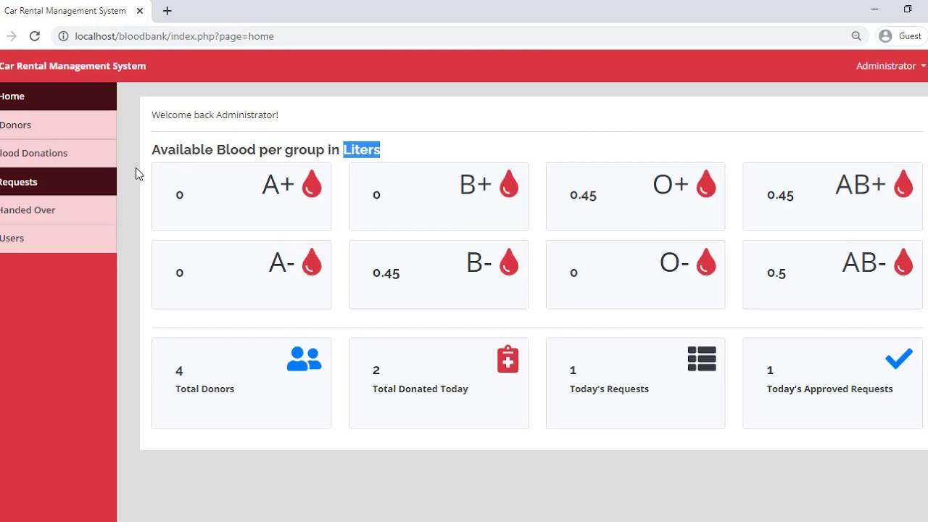

Slide 15
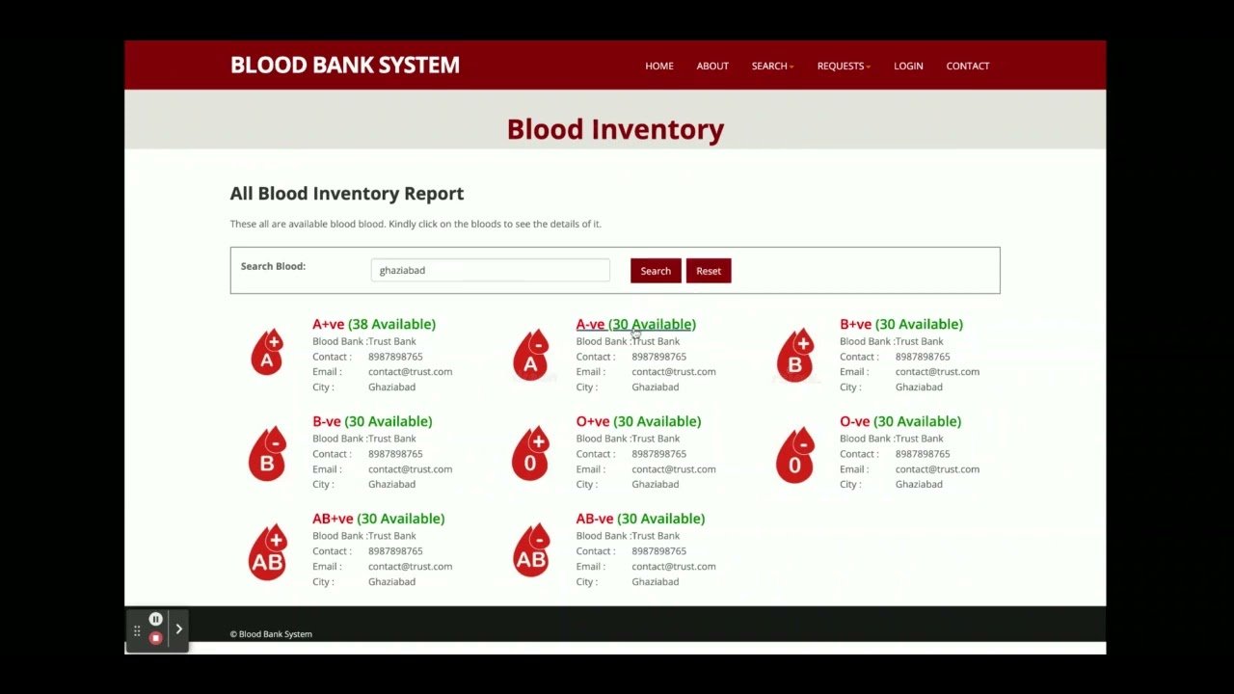

Slide 16
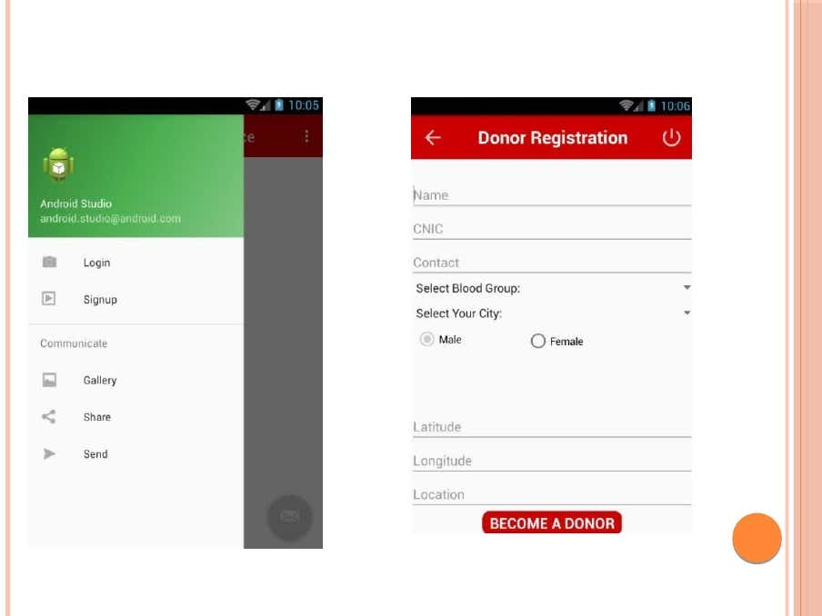

Slide 17
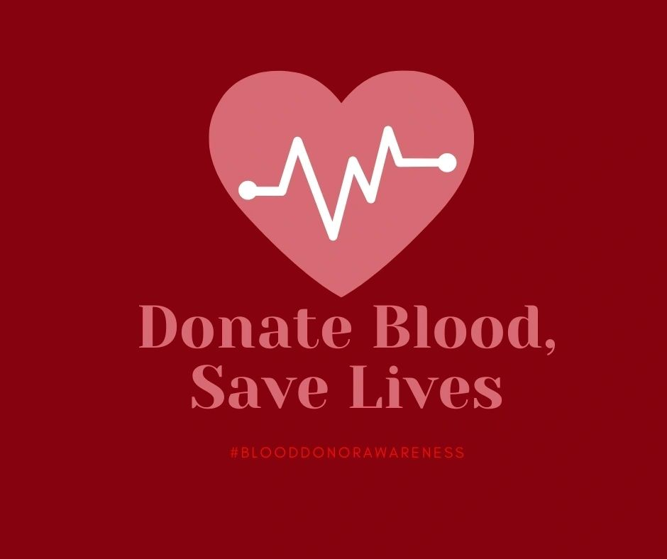
Conclusion
The Blood Bank and Organ Donation Management System is designed to make the process of organ donation simple, efficient, and reliable. It helps connect donors and recipients quickly while ensuring secure handling of their data. By providing real-time updates and easy access through a website and mobile app, the system reduces the time needed to find matching organs.

Slide 18
References
Abhay Yadav, et al. (2023). "Development of Mobile and Web-Based Platform for Organ Donation: Improving Donor-Recipient Matching and Awareness." Journal of Healthcare Technology, 32(1), 45-58.
The Better India. (2016). "Raising Awareness About Organ Donation in India: Overcoming Myths and Cultural Barriers." The Better India Blog.
Notto.gov.in. (2019). "National Organ and Tissue Transplantation Report: Trends and Real-Time Matching Systems." National Organ Transplant Organization.
V. B. Kute (2022). "Improving Renal Transplant Outcomes: A Study on Digital Platforms for Organ Tracking and Allocation." Indian Journal of Nephrology, 32(4), 271-279.
Chester County Hospital. (2021). "Health e-Living: Simplifying Organ Donation Registration Through Digital Platforms." Chester County Health Blog.
Transplant Quebec. (2019). "Improving Organ Donation and Transplantation Outcomes Through Public Education and Digital Solutions." Transplant Quebec Annual Report.

Slide 19
Aziz, A., et al. (2021). "A Comparative Study of Organ Donation Systems Across the World: Challenges and Technological Solutions." Global Health Journal, 27(2), 98-105.
Tepper, A., & Bhattacharya, S. (2020). "The Role of Artificial Intelligence in Organ Transplantation: Enhancing Matching and Predicting Outcomes." Journal of Medical Artificial Intelligence, 15(3), 208-214.
Stewart, M., & Harris, A. (2018). "The Impact of Public Awareness Campaigns on Organ Donation Registration: A Global Perspective." Transplantation Proceedings, 50(9), 2654-2660.
Smith, J. L., & Turner, R. (2017). "Advances in Organ Donation Technology: The Role of Mobile Applications in Increasing Donor Registrations." Journal of Organ Transplantation Technology, 21(1), 34-42.
World Health Organization. (2020). "Global Status Report on Organ Donation and Transplantation." World Health Organization.
Reddy, M., & Kumar, V. (2019). "The Future of Organ Donation: Incorporating Data Analytics for Real-Time Allocation and Matching." Journal of Health Informatics, 14(2), 112-120.

Slide 20
Smith, A., Johnson, R., & Lee, C. (2020)."Development of an Online Organ Donor Registry for Improved Organ Matching. "International Journal of Medical Informatics, 45(3), 123-130
Kumar, S., & Sharma, P. (2019). "Challenges and Solutions in Organ Donation Management Systems. "Journal of Healthcare Technology, 12(2), 87-95.
Gupta, R., & Singh, M. (2020)."Ensuring Data Privacy and Security in Healthcare Systems. "Advances in Cloud Computing and Secure Data, 18(1), 45-56.

Slide 21

For the attention

